Slide 1
Lesson objective
PBiS Focus
Respect – follow instruction
Achieve – complete all tasks
Title: Ratio in patterns
Aim:
Identify ratios in patterns
Calculate speed, distance and time
Plan:
Review ratios
Speed, distance and time
Need whiteboards and calculators.

Slide 2
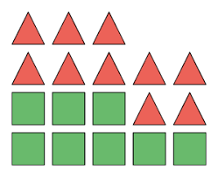
Simplify ratios – I do
Simplify these ratios:
a)
b) 15 : 25
Simplifying ratios (NO DECIMALS)
e.g. 7 : 21
So 1 : 3
THINK: what number goes into both numbers?

Slide 3
Simplify ratios – we do
Simplify these ratios:
12 : 4
15 : 3
81 : 27
Simplifying ratios (NO DECIMALS)
e.g. 7 : 21
So 1 : 3
THINK: what number goes into both numbers?

Slide 4
Whiteboards – you do
Simplify these ratios
20 : 5
16 : 12
8 : 24
9 : 6
Simplifying ratios (NO DECIMALS)
e.g. 7 : 21
So 1 : 3
THINK: what number goes into both numbers?

Slide 5
Sharing ratios – I do
SHARING with ratio
Add together the total number of parts of the ratio
Divide the given amount by the total number of parts
Multiply the answer by each ratio amount
Check that your answers add up to the same total given in the question
Share $100 into the ratio 2 : 3
Tom and sally split their 30 lollies into the ratio of 4 : 2. How many lollies does Tom get?
John’s garden needs to be trimmed, weeded and watered, it the ratio of 1 : 3 : 2. If he spends 12hrs in total, how long was he weeding?

Slide 6
Sharing ratio – we do
SHARING with ratio
Add together the total number of parts of the ratio
Divide the given amount by the total number of parts
Multiply the answer by each ratio amount
Check that your answers add up to the same total given in the question
Share 55cm into the ratio of 5 : 6
Sally and joe split their $500 rent into the ratio of 3 : 7, how much does joe spend on rent?
Tim splits his training into 3 activities, swimming, running and cycling into the ration of 1 : 3 : 4. If he trains for 88 days, how many days did he run for?

Slide 7
Whiteboards – you do
Share $45 into the ratio 2 : 3
Bill shares 32 lollies with Jane in the ratio of 5 : 3, how many lollies does Jane get?
Joe has a 12-week strength, hypertrophy and cardio program split into the ratio of 1 : 4 : 2. How many weeks does he focus on cardio?

Slide 8
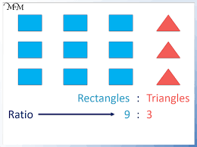
Patterns in ratios
How many triangles would there be if there were 81 rectangles?
How many squares would there be if there were 21 triangles?

Slide 9
Ratio
Notes:
How many triangles if there were 64 squares?
How many squares if there were 110 triangles?

Slide 10
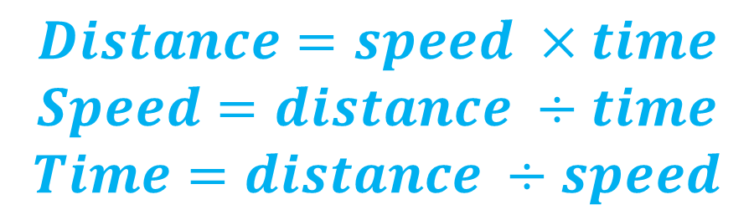
Speed, distance, time
Steps for success
Label the question SDT
Select formula
Substitute numbers
Solve
$$Distance=speed ×time$$
$$Speed=distance ÷time$$
$$Time=distance ÷speed$$

Slide 11
I do
Label the question SDT
Select formula
Substitute numbers
Solve
Tim travels at 25km/p for 5 hours. How far will Tim travel?
Joe travelled 450km in 9 hours. What was his average speed?
If Sally is traveling at 65km/h, how long will it take her to travel 487.5 km?

Slide 12
We do
Label the question SDT
Select formula
Substitute numbers
Solve
Sally drives for 6 hours at 55km/h, how far has she travelled?
A water tank can hold 2500L, if it is filling up at 125L per minute, how long will it take to fill?
Joe ran 500m in 63 seconds. How fast was he going in meters per second?

Slide 13
Whiteboards – you do
Joe travels 560km in 8 hours, what was his average speed?
Sally runs at 8m per second. How far will she travel after 45 seconds?
A cheetah runs at 22m/s, how long will it take to run 902m?

